Slide 1


Computational Intelligence (TC3023)

Slide 2

Unit 1 – Introduction to Computational Learning
Outline
Cyber Security Foundations
What is Machine Learning?
Machine Learning and Cyber Security
Ethics Questions
Practical Example of Machine Learning

Slide 3
Cyber Security Foundations

Slide 4
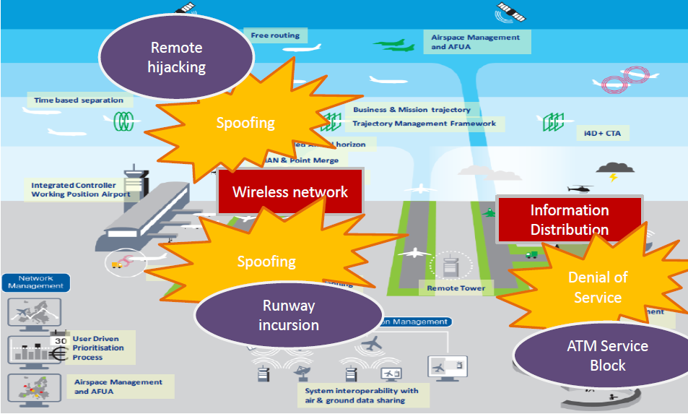
How does produce an attack into the Air Traffic Management System?

Slide 5
How to produce an attack into the Air Traffic Management System?
There are a set of attack vectors to produce the consequence;
Requires deep knowledge to produces; and
Requires an unusual chain of failures.

Slide 6


However, if the attack occurs, the consequences can be catastrophic and irrecoverable!

Slide 7
Ukraine Power Grid Cyberattack Autopsy
What assets do we need to protect?
How are those assets threatened?
Can all assets in the network be protected?
What is the value of each asset for my business?
Can the attack kill-chain used to perform the attack be predicted?
What can we do to counter those threats?
If the kill-chain cannot be predicted, in most cases, what can we do?
23 December 2015

Slide 8
What is cyber security?
“Prevention of damage to, protection of, and restoration of computers, electronic communications systems, electronic communications services, wire communication, and electronic communication, including information contained therein, to ensure its availability, integrity, authentication, confidentiality, and nonrepudiation.”
National Security Presidential Directive 54/Homeland Security Presidential Directive 23 (NSPD- 54/HSPD-23)

Slide 9
Cyber Security Concepts
Asset: Something of value to a person, business, or organization.
“… electronic communications systems, electronic communications services, wire communication, and electronic communication, including information contained therein…”

Slide 10
Cyber Security Concepts
Threat: Something that could cause harm to a system or organization.
Vulnerability: A flaw or weakness that can be used to attack a system or organization.
Exploit: is an attack on a computer system, especially one that takes advantage of a particular vulnerability the system offers to intruders. An exploit takes advantage of a weakness in an operating system, application or any other software code, including application plug-ins or software libraries.

Slide 11


Slide 12
Cyber Security Attributes
Availability: Ensuring timely and reliable access to and use of information. A loss of availability is the disruption of access to or use of information or an information system.
Integrity: Guarding against improper information modification or destruction, including ensuring information nonrepudiation and authenticity. A loss of integrity is the unauthorized modification or destruction of information.
Confidentiality: Preserving authorized restrictions on information access and disclosure, including means for protecting personal privacy and proprietary information. A loss of confidentiality is the unauthorized disclosure of information

Slide 13
Cyber Security Attributes
Authenticity: The property of being genuine and being able to be verified and trusted; confidence in the validity of a transmission, a message, or message.
Nonrepudiation: is the assurance that someone cannot deny something. Typically, nonrepudiation refers to the ability to ensure that a party to a contract or a communication cannot deny the authenticity of their signature on a document or the sending of a message that they originated.

Slide 14
Cyber Security Attributes
Privacy: Assures that individual's control or influence what information related to them may be collected and stored and by whom and to whom that information may be disclosed.

Slide 15
Exploits Targets
disclosure of data (violation of the confidentiality attribute)
modification of data (violation of the integrity attribute)
insertion of false data (violation of the integrity attribute)
destruction of data (violation of the availability attribute)
interruption of access to data (violation of the availability attribute)
system destruction, destabilization, or degradation (violation of the availability attribute)
Alberts, Christopher & Dorofee, Audrey Managing Information Security Risks: The OCTAVE Approach. Addison-Wesley. 2003.

Slide 16

Attack Surface
Software has errors
Error causes software to behave differently from the intended behavior
Vulnerability is an error that can be exploited by an attacker

Slide 17
Attack Surface
A system’s attack surface is the subset of the system’s resources - methods (e.g., API), channels (e.g., sockets), and data - potentially used in attacks on the system.
Attack Surface of a Connected Vehicle
Manadhata, Pratyusa K., et al. An approach to measuring a system's attack surface. No. CMU-CS-07-146. CARNEGIE-MELLON UNIV PITTSBURGH PA SCHOOL OF COMPUTER SCIENCE, 2007.

Slide 18
Risk Management
Risk Management
Identify
Analyze
Action
Monitor
Control
Risk management is the identification, evaluation, and prioritization of risks (effect of uncertainty on objectives) followed by coordinated and economical application of resources to minimize, monitor, and control the probability or impact of unfortunate events or to maximize the realization of opportunities.
ISO/IEC Guide 73:2009 (2009). Risk management — Vocabulary. International Organization for Standardization.

Slide 19
Risk Components and Measures
Uncertainty, which can be measured via probabilities, is involved in all components.
Can you give examples of each?
A more elaborate analysis must consider them all.
Probabilities would be mostly conditional, requiring a more careful analysis.
CONDITION
(passive element)
POTENTIAL EVENT
PROBABILITY
CONSEQUENCE
(loss)
EXPOSURE
IMPACT
Risk Management is a systematic approach for minimizing exposure to potential losses.
TIME FRAME

Slide 20
From a Cyber Perspective….
VULNERABILITY
THREAT
EXPLOIT
CONDITION
(passive element)
POTENTIAL EVENT
CONSEQUENCE
(loss)

Slide 21
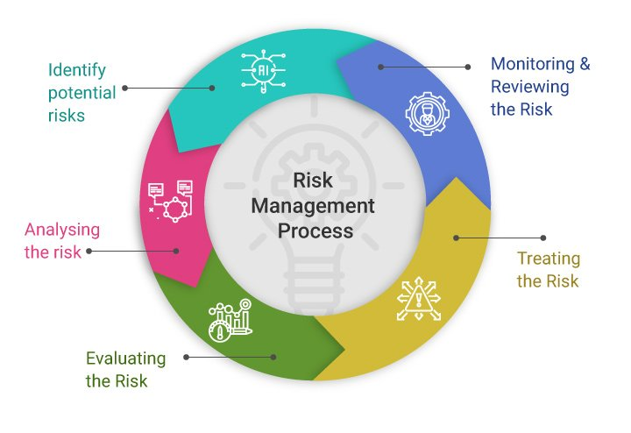
Risk Management Process

Slide 22
Why Preventive Measures is not enough
Inherent weaknesses in increasingly more complex systems/networks
Poor Design (Software and hardware)
Example: sendmail (race condition vulnerability, buffer overflow, group permission vulnerability, etc.)
Poor Implementation
Security an afterthought
Lack of personnel experience/training
Poor system configuration
Example: default firewall configurations with open insecure ports

Slide 23
Why Preventive Measures is not enough
Poor Management: Inadequate policies/procedures
Tradeoff between security and usability
Non-tech tradeoffs in system engineering
social, organizational, economic, regulatory, legal
Cost of prevention

Slide 24

Attack Categories
Probe
Information gathering (1:1, 1:m, m:1, m:n modes)
IPSweep, portsweep, nmap, etc.
Denial of Service (DoS)
TCP SYN flood, Ping of Death, smurf, neptune, etc.
Remote to Local attacks (R2L)
Brute force/Dictionary attack, buffer overflow, unverified input attacks
Social engineering, Trojans
User to Root attacks (U2R)
Buffer overflow, rootkit, etc.
Infections
Trojans/worms/viruses
Spreading attacks

Slide 25

Basic Attack Steps
Prepare
Gather info: Valid IP addresses & ports, OS, software type & version
Exploit
Leave behind (Backdoors)
Clean up
Restart crashed daemons, clean registry/log files
Variable order and duration
Attacker’s skill level
Type of vulnerability to exploit
Prior knowledge
Starting location of attacker

Slide 26
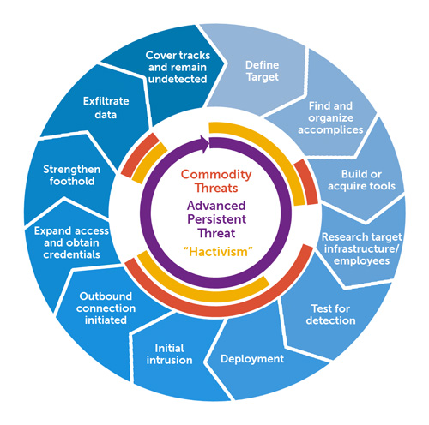
Advanced Persistence Threats (APT)
Targeted attack against a high-value asset
Low and slow
Avoid alerts
Use stolen user credentials
Zero-day exploits
Low profile in network
Slow progress: Operating over months or years
Beyond limited correlation time windows of today’s IDSs
Multi-stage
Exploitation
Command and control
Lateral movement
Breach

Slide 27
Advanced Persistence Threats (APT)
Typical Goals
Steal intellectual property (IP)
Gain access to sensitive customer data
Access strategic business information
Financial gain, embarrassment, blackmail, data poisoning, illegal insider trading, disrupting organization’s business
Attackers
Well-funded
Highly skilled
Motivated
Targeted on specific data from specific organization

Slide 28
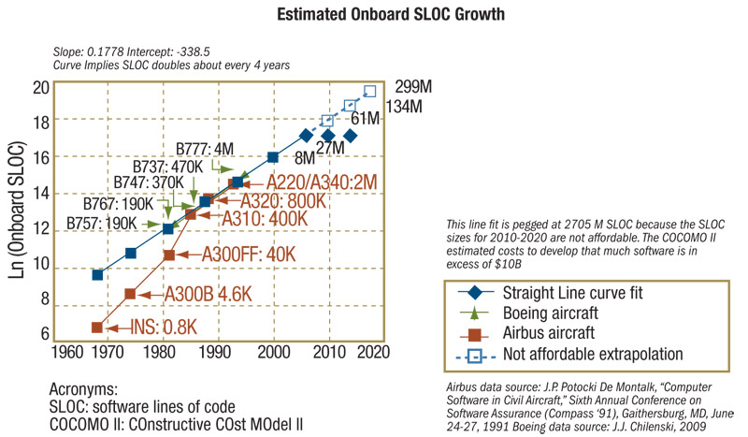
Failure to prevention
Source: St Clair, B. Growing Complexity Drives Need for Emerging DO-178C Standard. Nov 2009. http://www.cotsjournalonline.com

Slide 29
Failure to prevention
Attack mechanisms constantly evolving/ mutating
New connectivity options bypassing perimeter security
Preventive measures getting obsolete
Polymorphic viruses resistant to current antivirus

Slide 30
Defense Security
1st Generation: Intrusion detection systems (IDS)
100% protection/prevention impossible
Layered security
2nd Generation: Security information and event management (SIEM)
Correlate alerts from different intrusion detection sensors
Present actionable information to security analyst
3rd Generation: Big Data analytics for security
Contextual security intelligence
Long-term correlations

Slide 31
What is Machine Learning?

Slide 32

What is Machine Learning?
[Machine Learning is the] field of study that gives computers the ability to learn without being explicitly programmed.
Arthur Samuel, 1959
A computer program is said to learn from experience E with respect to some task T and some performance measure P, if its performance on T, as measured by P, improves with experience E.
Tom Mitchell, 1997

Slide 33

ML Example – Spam Filter

Slide 34
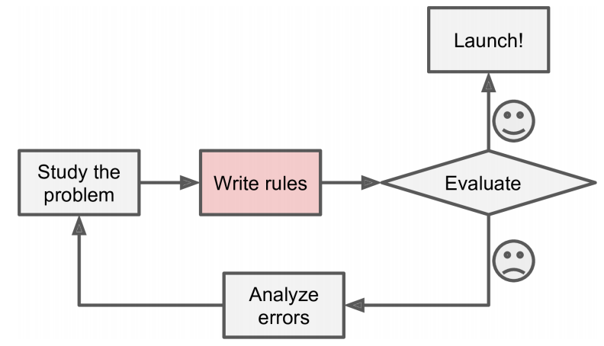
ML Example – Spam Filter
Traditional Approach
Since the problem is not trivial, your program will likely become a long list of complex rules -hard to maintain.

Slide 35
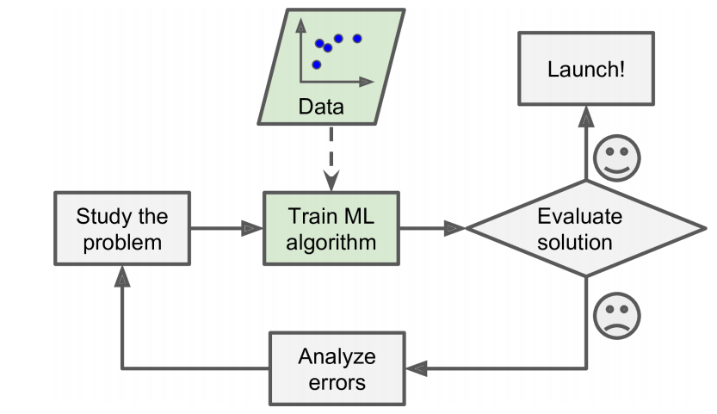
ML Example – Spam Filter
In contrast, a spam filter based on Machine Learning techniques automatically learns which words and phrases are good predictors of spam by detecting unusually frequent patterns of words in the spam examples compared to the ham examples.
ML Approach

Slide 36
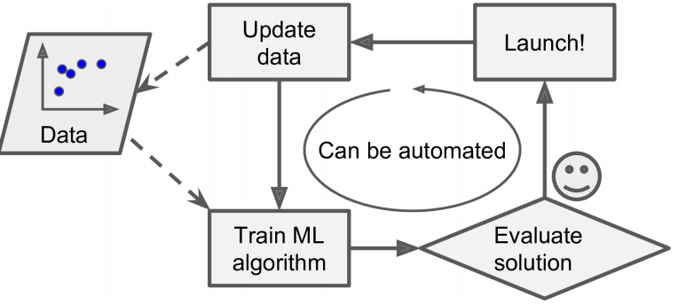
ML Example – Spam Filter
Another advantage is that the models are adaptable, being able to learn from the insertion of new data, without the need to adjust the learning structure.
ML Approach

Slide 37

ML is amazing for …
Problems for which existing solutions require a lot of hand-tuning or long lists of rules: one Machine Learning algorithm can often simplify code and perform better.
Complex problems for which there is no good solution at all using a traditional approach: the best Machine Learning techniques can find a solution.
Fluctuating environments: a Machine Learning system can adapt to new data.
Getting insights about complex problems and large amounts of data.

Slide 38

Types of Machine Learning Systems
Whether or not they are trained with human supervision (supervised, unsupervised, semi-supervised, and Reinforcement Learning)
Whether or not they can learn incrementally on the fly (online versus batch learning)
Whether they work by simply comparing new data points to known data points, or instead detect patterns in the training data and build a predictive model, much like scientists do (instance-based versus model-based learning)

Slide 39
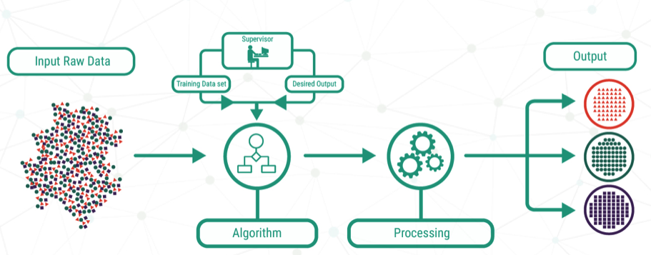
Supervised learning
Supervised machine learning requires data scientists to train the algorithm how to output the correct result for a given input dataset.
Essentially, this requires feeding the algorithm a large amount of data, along with the conclusions that the machine is expected to draw from that data.

Slide 40
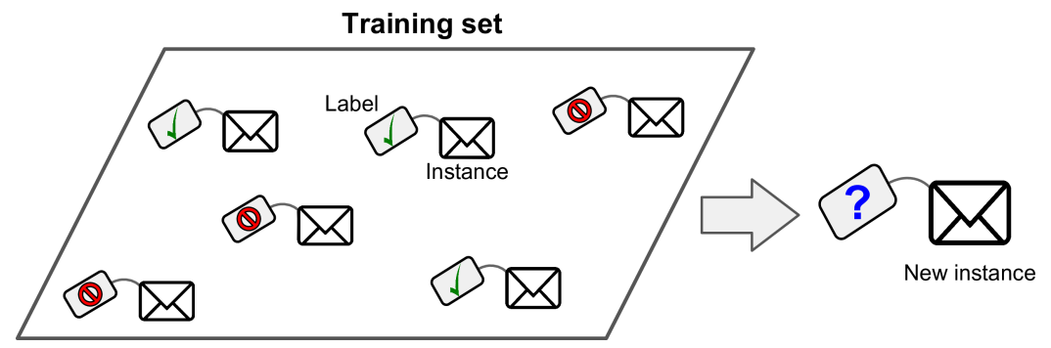
Supervised learning
In supervised learning, the training data you feed to the algorithm includes the desired solutions, called labels.

Slide 41
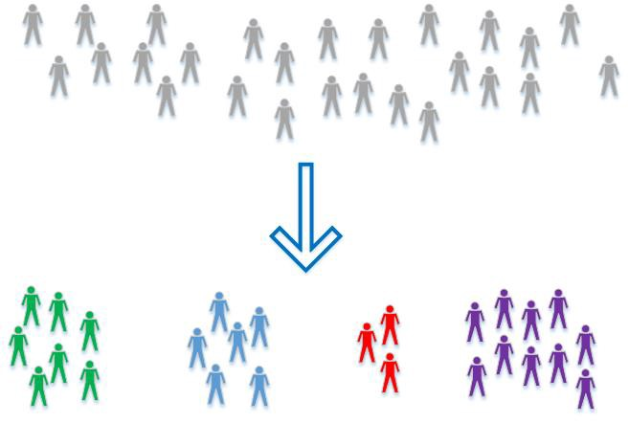
Unsupervised learning
Unsupervised learning is more complex than supervised learning but opens the doors for a unique set of applications.
Unsupervised learning has no training phase; instead, the algorithm is simply handed a dataset and uses the variables within the data to identify and separate out natural clusters.
There is no label.

Slide 42
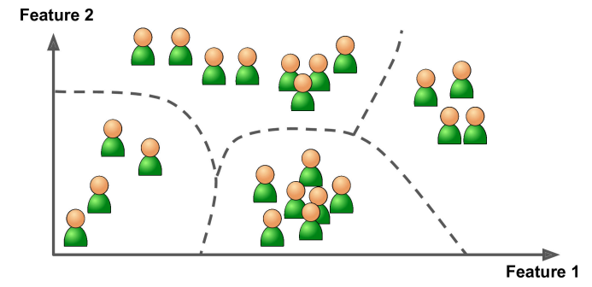
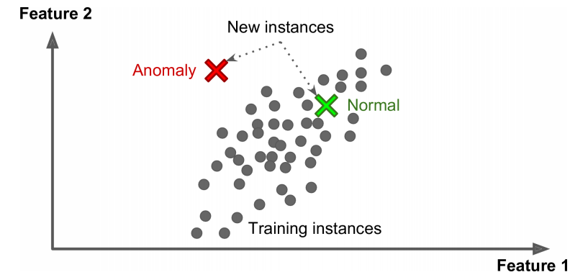
Unsupervised learning
Clustering
Anomaly Detection

Slide 43
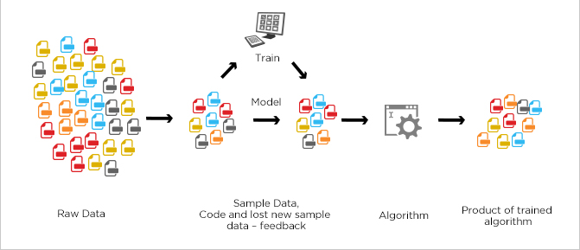
Semi-supervised learning
As the name suggests, semi-supervised learning is a bit of both supervised and unsupervised learning and uses both labeled and unlabeled data for training.
In a typical scenario, the algorithm would use a small amount of labeled data with a large amount of unlabeled data.

Slide 44
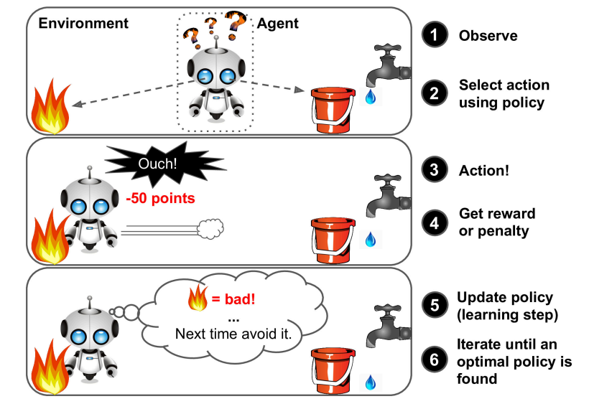
Reinforcement Learning
The learning system, called an agent in this context, can observe the environment, select and perform actions, and get rewards in return (or penalties in the form of negative rewards).
It must then learn by itself what is the best strategy, called a policy, to get the most reward over time.
A policy defines what action the agent should choose when it is in each situation.

Slide 45
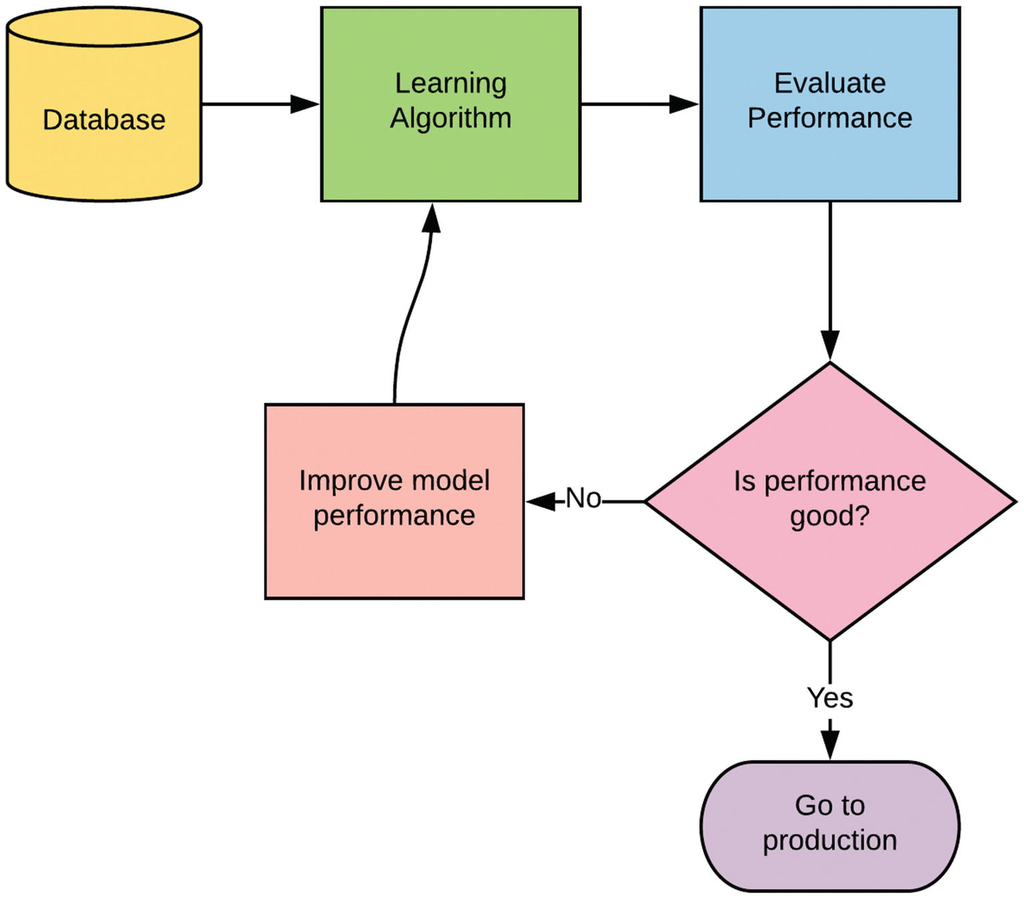
Batch Learning
The system is incapable of learning incrementally: it must be trained using all the available data.
This will generally take a lot of time and computing resources, so it is typically done offline.
First the system is trained, and then it is launched into production and runs without learning anymore; it just applies what it has learned.

Slide 46
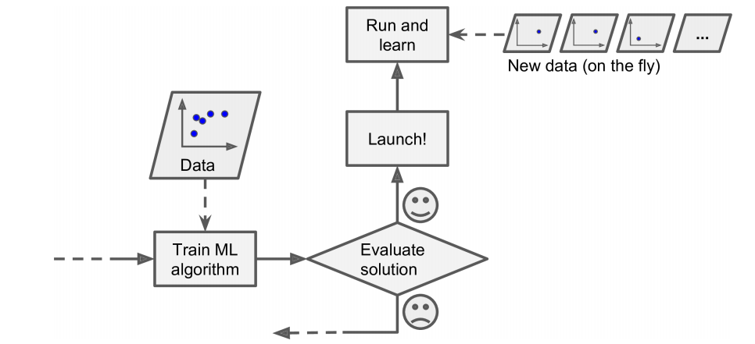
Online Learning
You train the system incrementally by feeding it data instances sequentially, either individually or by small groups called mini-batches.
Each learning step is fast and cheap, so the system can learn about new data on the fly, as it arrives.

Slide 47
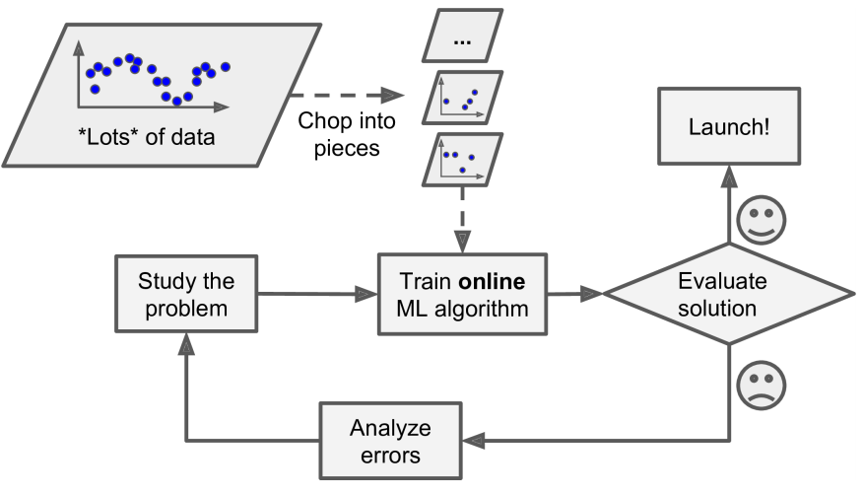
Online Learning
Online learning algorithms can also be used to train systems on huge datasets that cannot fit in one machine’s main memory (this is called out-of-core learning).
One important parameter of online learning systems is how fast they should adapt to changing data: this is called the learning rate.
A big challenge with online learning is that if bad data is fed to the system, the system’s performance will gradually decline.

Slide 48
ML Challenges
Insufficient Quantity of Training Data
Nonrepresentative Training Data
Poor-Quality Data: training data with full of errors, outliers, and noise.
Irrelevant Features: Your system will only be capable of learning if the training data contains enough relevant features and not too many irrelevant ones.
Overfitting the Training Data: it means that the model performs well on the training data, but it does not generalize well.
Underfitting the Training Data: it occurs when your model is too simple to learn the underlying structure of the data.

Slide 49
Machine Learning and Cyber Security

Slide 50
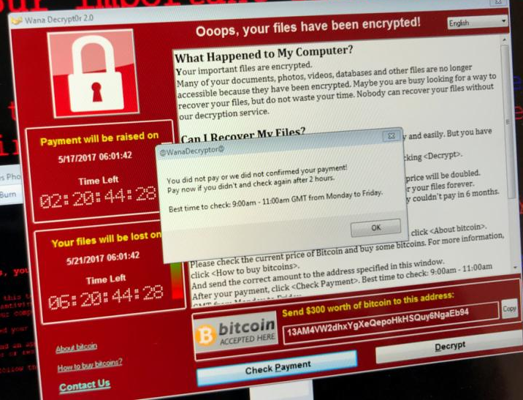
Why do I need to use ML in Cybersecurity?
In May of 2017, a nasty cyber attack hit more than 200,000 computers in 150 countries over the course of just a few days.
Dubbed “WannaCry” it exploited a vulnerability that was first discovered by the National Security Agency (NSA) and later stolen and disseminated online.

Slide 51

Why do I need to use ML in Cybersecurity?
But in 2018 alone, there were 10.5 billion malware attacks.
That's too much volume for humans to handle.

Slide 52

Why do I need to use ML in Cybersecurity?
Here are just some of the benefits Machine Learning offers cybersecurity for businesses and consumers:
Thorough, hands-off system scanning for data breaches, malware, and more
Endpoint protection through quick remediation
Fast analysis of large amounts of data
Adjustments without the need for expert input

Slide 53

Does ML enough to combat cyber criminals?
Machine learning does some things well, such as quickly scanning large amounts of data and analyzing it using statistics.
“We have more and more data available, and the data is generally telling a story”
“If you understand how to analyze the data, you should be able to come up with the deviations from the norm.”
And those deviations sometimes reveal threats.
HUMAN ANALYSIS IS CRITICAL!!!!

Slide 54
Ethics Questions

Slide 55
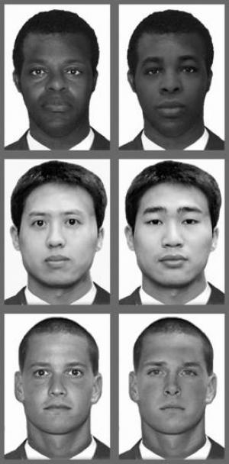
Biases in AI systems
AI has become increasingly inherent in facial and voice recognition systems.
Some of these systems have real business applications and directly impact people.
These systems are vulnerable to biases and errors introduced by its human creators.
Also, the data used to train these AI systems itself can have biases.

Slide 56
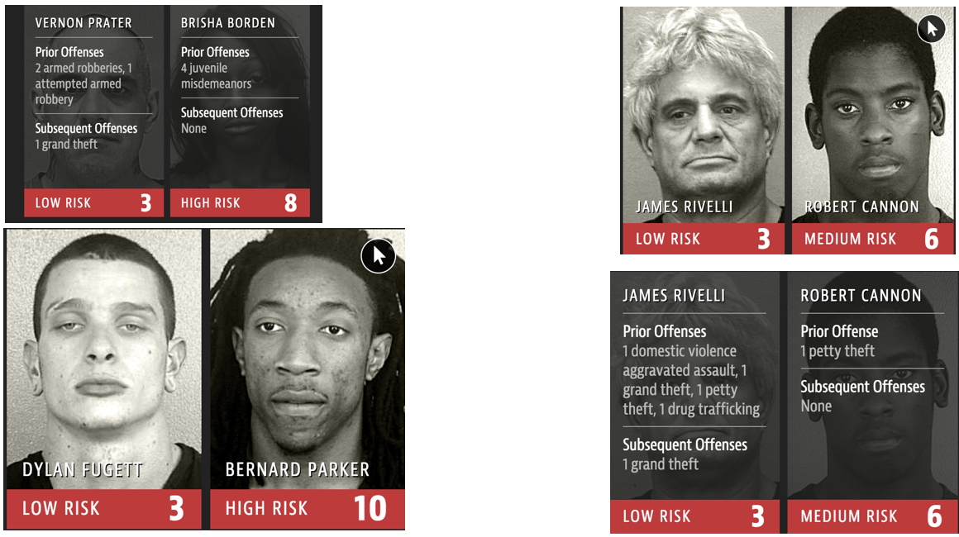
Biases in AI systems
Above is an example of approximation model output based on the risk assessment software called COMPAS which was created by the company Northpointe.
The COMPAS software predicts the likelihood of a person reoffending and uses such factors such as poverty, joblessness and other variables (although race isn’t included in their assessment directly) and used by judges to gauge sentence harshness and length.

Slide 57

Liability for self-driving cars
Who is the responsible party if autonomous cars get into accidents?

Slide 58

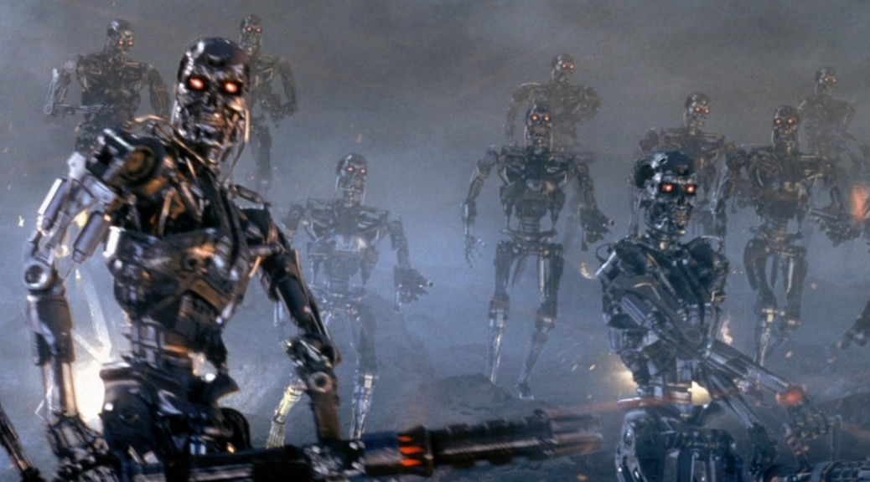
Weaponization of artificial intelligence
Who is the responsible party if autonomous cars get into accidents?

Slide 59
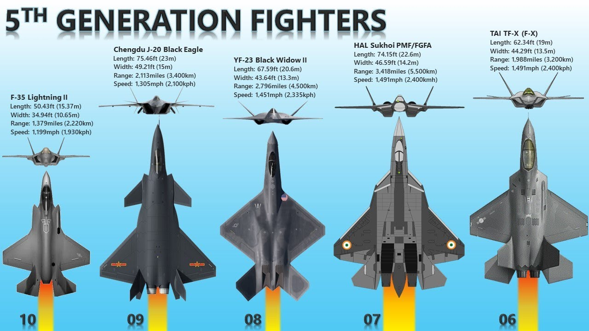
Weaponization of artificial intelligence
Who is the responsible party if autonomous cars get into accidents?

Slide 60
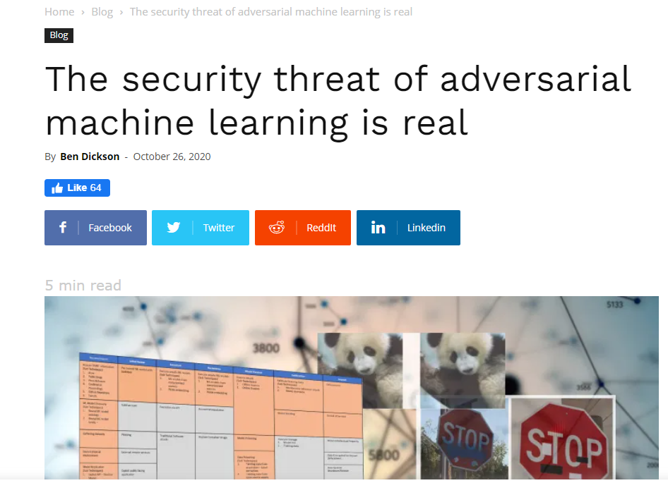
https://bdtechtalks.com/2020/10/26/adversarial-machine-learning-threat-matrix/
Who is the responsible party if autonomous cars get into accidents?

Slide 61
A Practical Example (Password-Strength-Analysis)

Slide 62

Anaconda Individual Edition
Anaconda is a distribution of the Python and R programming languages for scientific computing (data science, machine learning applications, large-scale data processing, predictive analytics, etc.), that aims to simplify package management and deployment.
The distribution includes data-science packages suitable for Windows, Linux, and macOS.
https://www.anaconda.com/products/individual

Slide 63
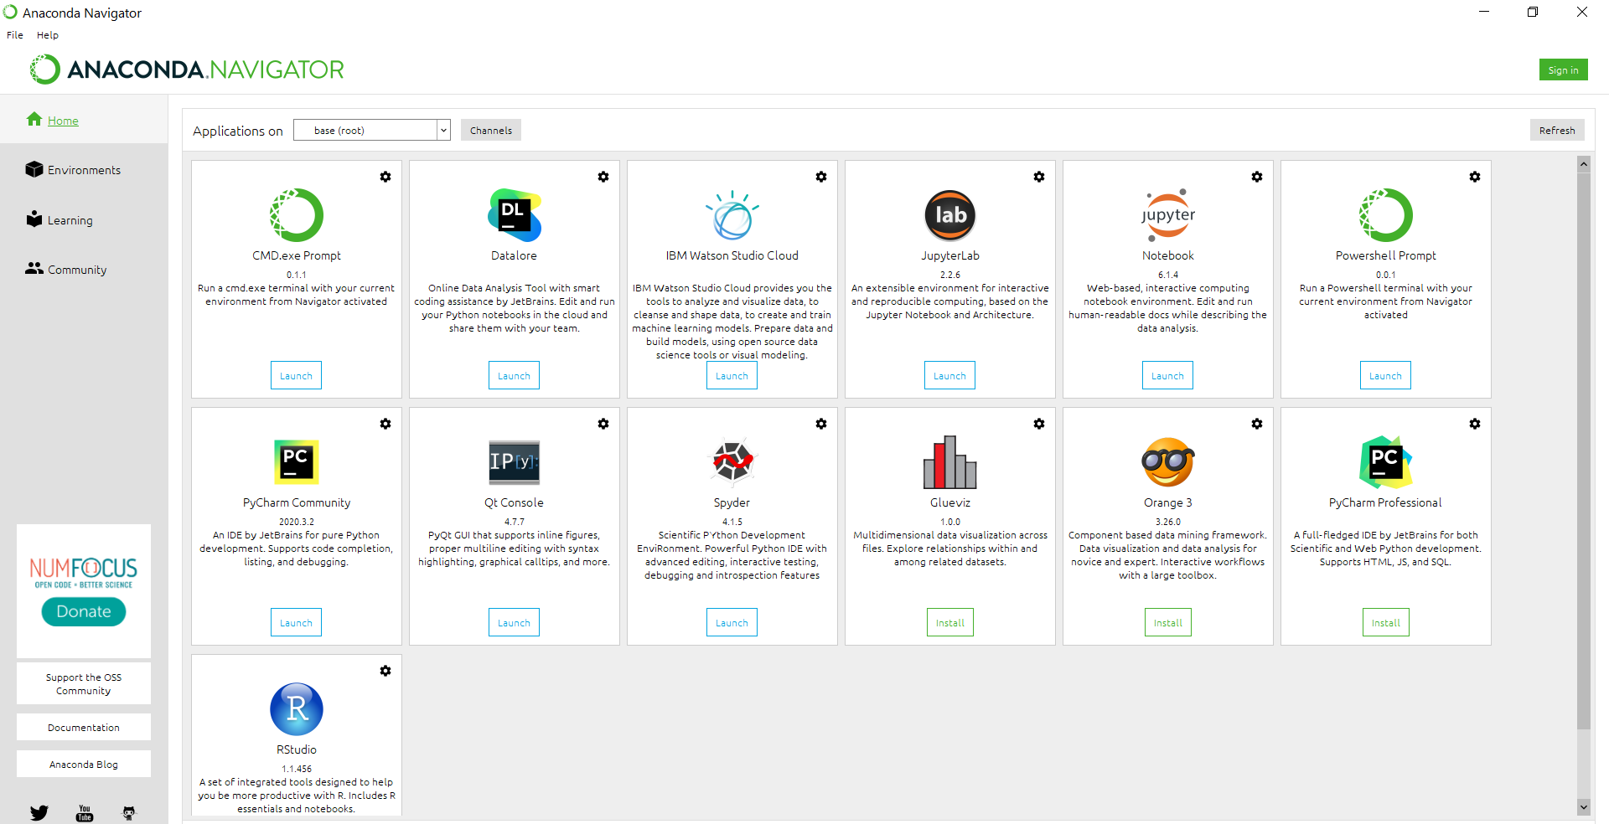

Slide 64

Jupyter Notebooks
Jupyter Notebook (formerly IPython Notebooks) is a web-based interactive computational environment for creating Jupyter notebook documents.
The "notebook" term can colloquially make reference to many different entities, mainly the Jupyter web application, Jupyter Python web server, or Jupyter document format depending on context.
A Jupyter Notebook document is a JSON document, following a versioned schema, containing an ordered list of input/output cells which can contain code, text (using Markdown), mathematics, plots and rich media, usually ending with the ".ipynb" extension.

Slide 65

PyCharm IDE
PyCharm is an integrated development environment (IDE) used in computer programming, specifically for the Python language.
It provides code analysis, a graphical debugger, an integrated unit tester, integration with version control systems (VCSes), and supports web development with Django as well as data science with Anaconda.
PyCharm is cross-platform, with Windows, macOS and Linux versions. The Community Edition is released under the Apache License, and there is also Professional Edition with extra features – released under a proprietary license.

Slide 66
Anaconda Navigator Environment

Slide 67
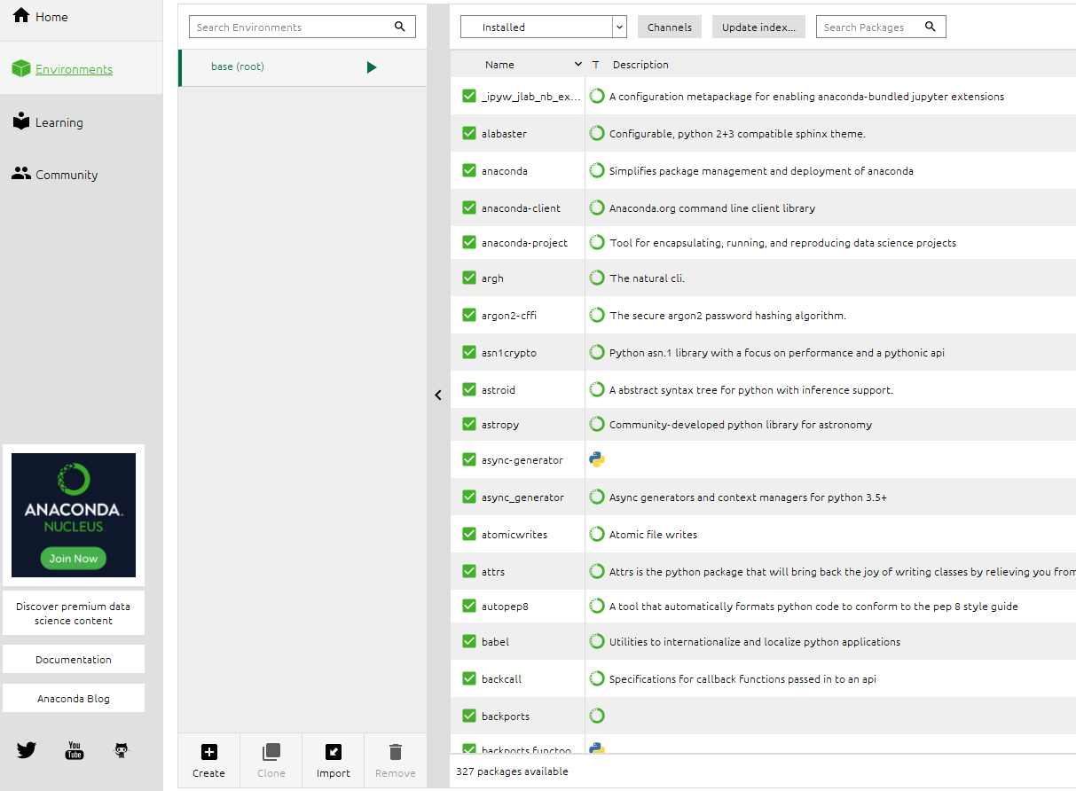
Anaconda Navigator Environment

Slide 68
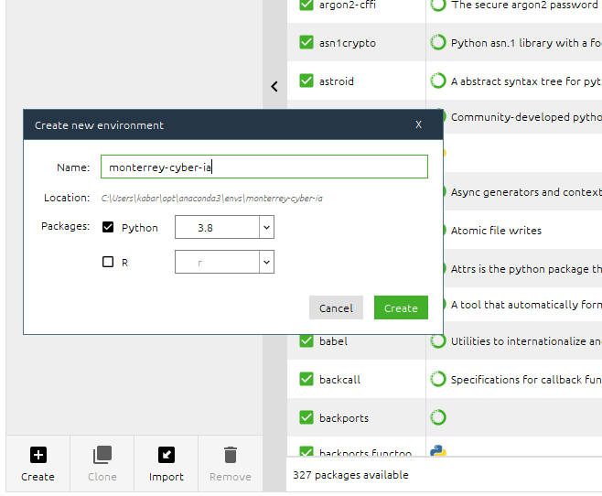
Creating a new Environment
Creating an environment is a good approach when you have multiples projects in the same machine.

Slide 69
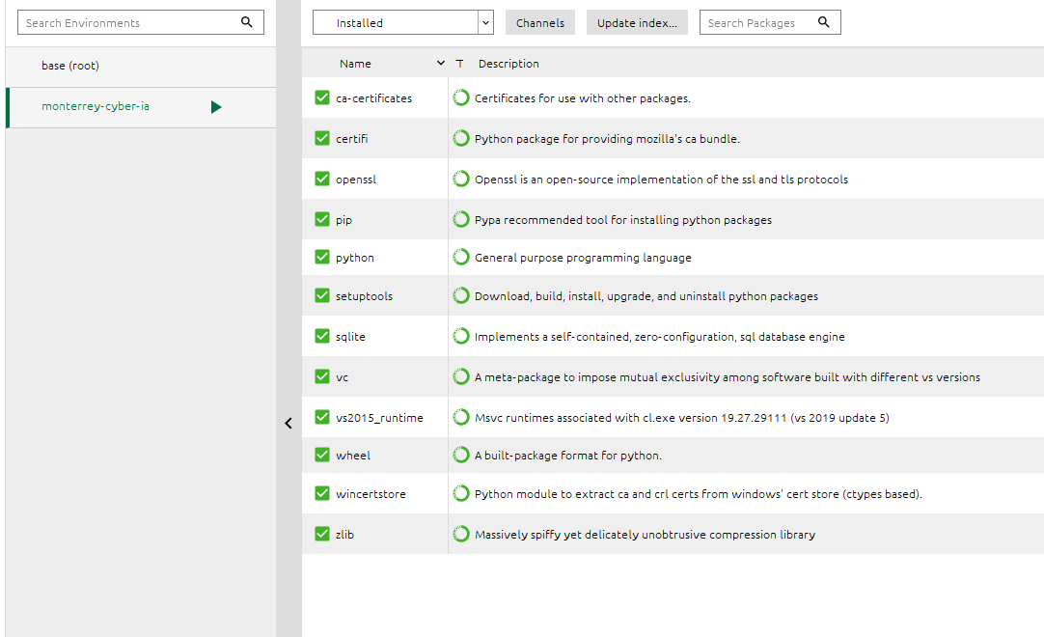
Creating a new Environment
Perceives that the new environment has a few libraries pre-installed.

Slide 70
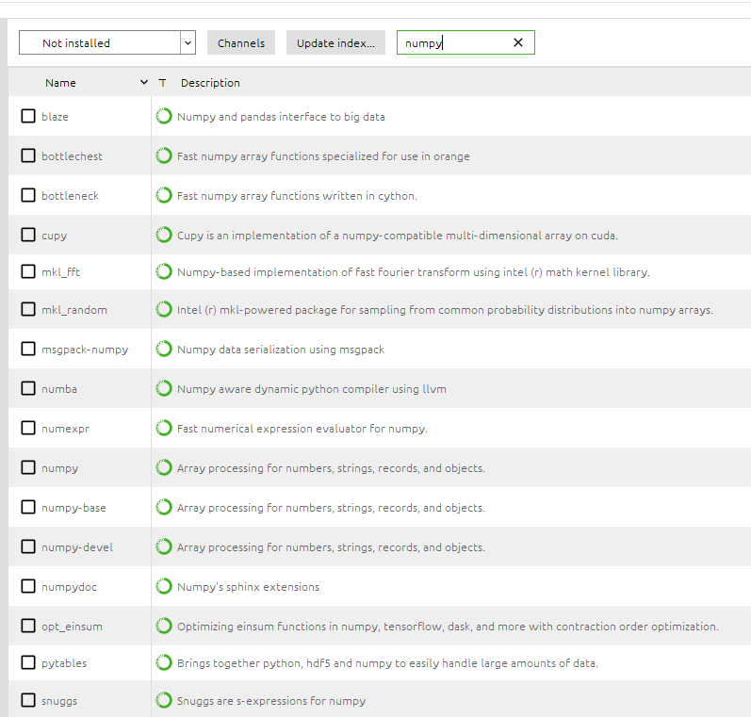
Install libraries
v
A good idea is to install a set of important libraries that most of project requires (numpy, pandas).
v

Slide 71
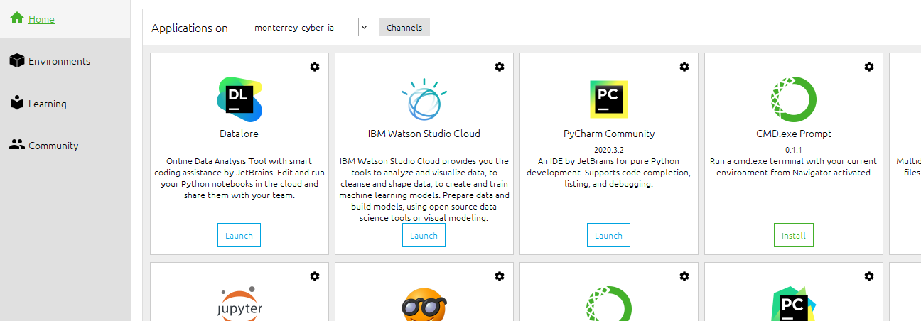
Run the IDE

Slide 72
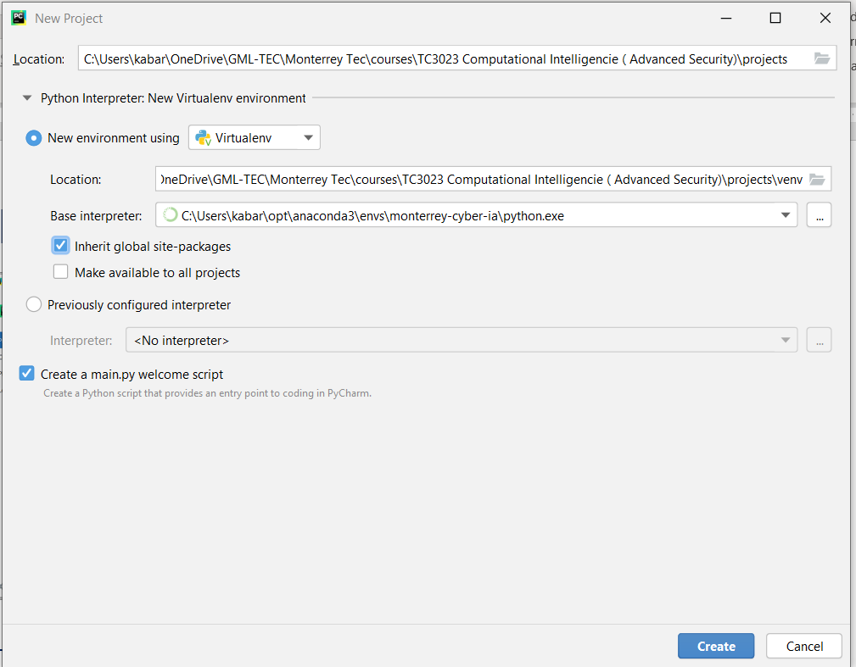
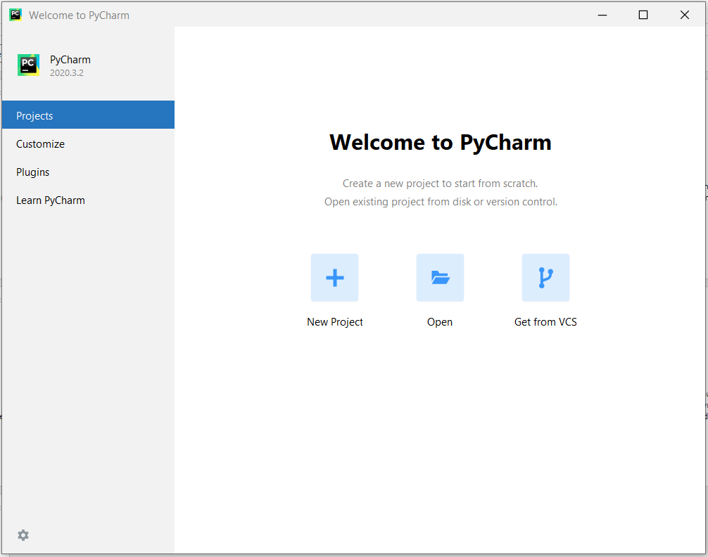
PyCharm

Slide 73
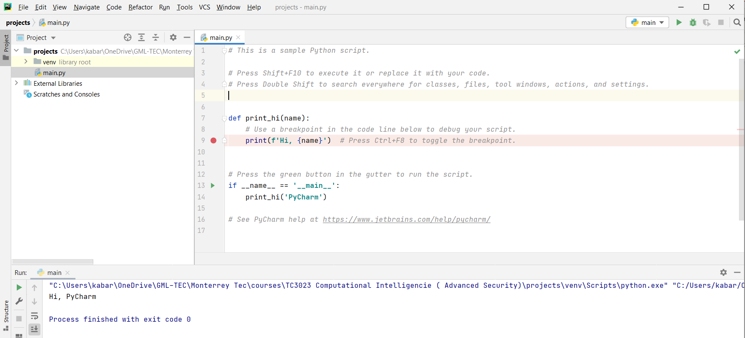
Name of Class that will be run or debug

Slide 74
Popular Open Data Repositories
UC Irvine Machine Learning Repository
Kaggle datasets
Amazon’s AWS datasets
Meta portals (they list open data repositories):
http://dataportals.org/
http://opendatamonitor.eu/
http://quandl.com/

Slide 75
Some specific cyber security datasets
MAWILab
Malware Training Sets
Comprehensive, Multi-Source Cyber-Security Events
Malicious URLs
ADFA Intrusion Detection Datasets
Unified Host and Network Data Set
User-Computer Authentication Associations in Time
CTU-13 Dataset
Aposemat IoT-23
EMBER
Other Dataset information:
https://cyberdatascientist.com/datasets/
https://www.kaggle.com/general/6780

Slide 76

The Problem
A big issue in Cyber security is weak passwords.
The idea of our model is to classify the password, based on its strongness:
[0] for weak;
[1] for medium; and
[2] for strong.

Slide 77
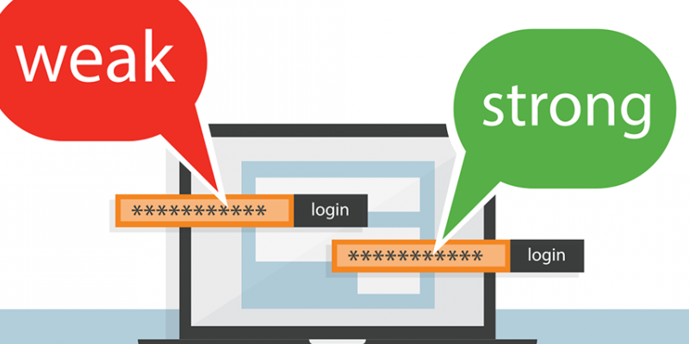
Password Dataset
The dataset used in our analysis are from 000webhost leak that is available online.
How did we figure out which passwords were stronger, and which were weaker?
There is a tool called PARS by Georgia Tech university which have all the commercial password meters integrated into it.
All I did was give that tool all the passwords and it gave me new files for each commercial password strength meter.

Slide 78
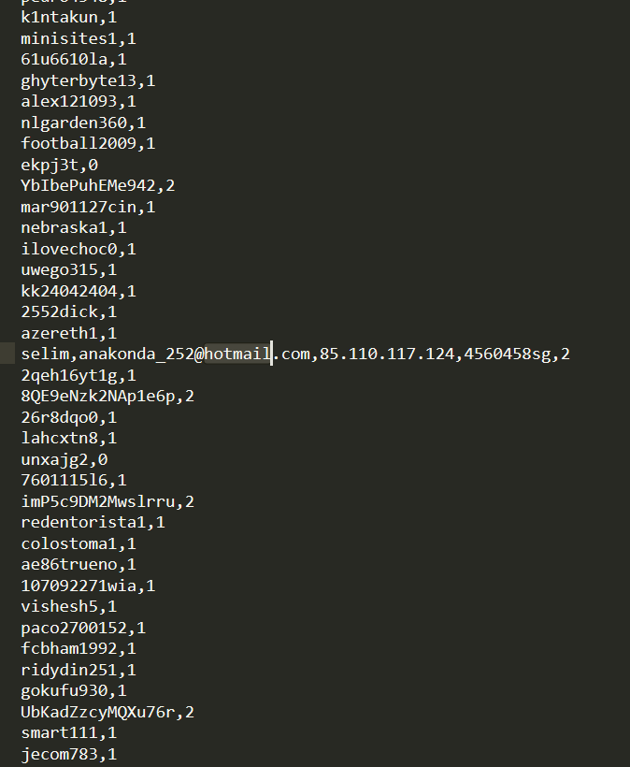
Password Dataset
[password, score]
[0] for weak;
[1] for medium; and
[2] for strong.

Slide 79
Fixing Dataset errors
from csv import reader from csv import writer def adjust_file (input_file_name, output_file_name ): csv_out = open(output_file_name, "w",encoding="utf8",newline='') csv_writer = writer(csv_out) lines = list() with open(input_file_name, 'r',encoding="utf8") as read_obj: # pass the file object to reader() to get the reader object csv_reader = reader(read_obj) # Iterate over each row in the csv using reader object for row in csv_reader: lines.append(row) if (len(row) >2): lines.remove(row) csv_writer.writerows(lines) csv_out.close()

Slide 80
Logistic Regression
Logistic regression is a classification algorithm used to assign observations to a discrete set of classes (Ex.: Email spam or not spam, Online transactions Fraud or not Fraud, Tumor Malignant or Benign).
Logistic regression transforms its output using the logistic sigmoid function to return a probability value.
What are the types of logistic regression
Binary (eg. Tumor Malignant or Benign)
Multi-linear (eg. Cats, dogs or Sheep's)

Slide 81
How Logistic Regression is used?
It is important to understand that logistic regression should only be used when the target variables fall into discrete categories and that if there’s a range of continuous values the target value might be, logistic regression should not be used.
Example:
Predicting if an email is spam or not spam
Whether a tumor is malignant or benign
Whether a mushroom is poisonous or edible.

Slide 82

How Logistic Regression is used?
A threshold is usually specified that indicates at what value the example will be put into one class vs. the other class.
In the spam classification task, a threshold of 0.5 might be set, which would cause an email with a 50% or greater probability of being spam to be classified as “spam” and any email with probability less than 50% classified as “not spam”.

Slide 83
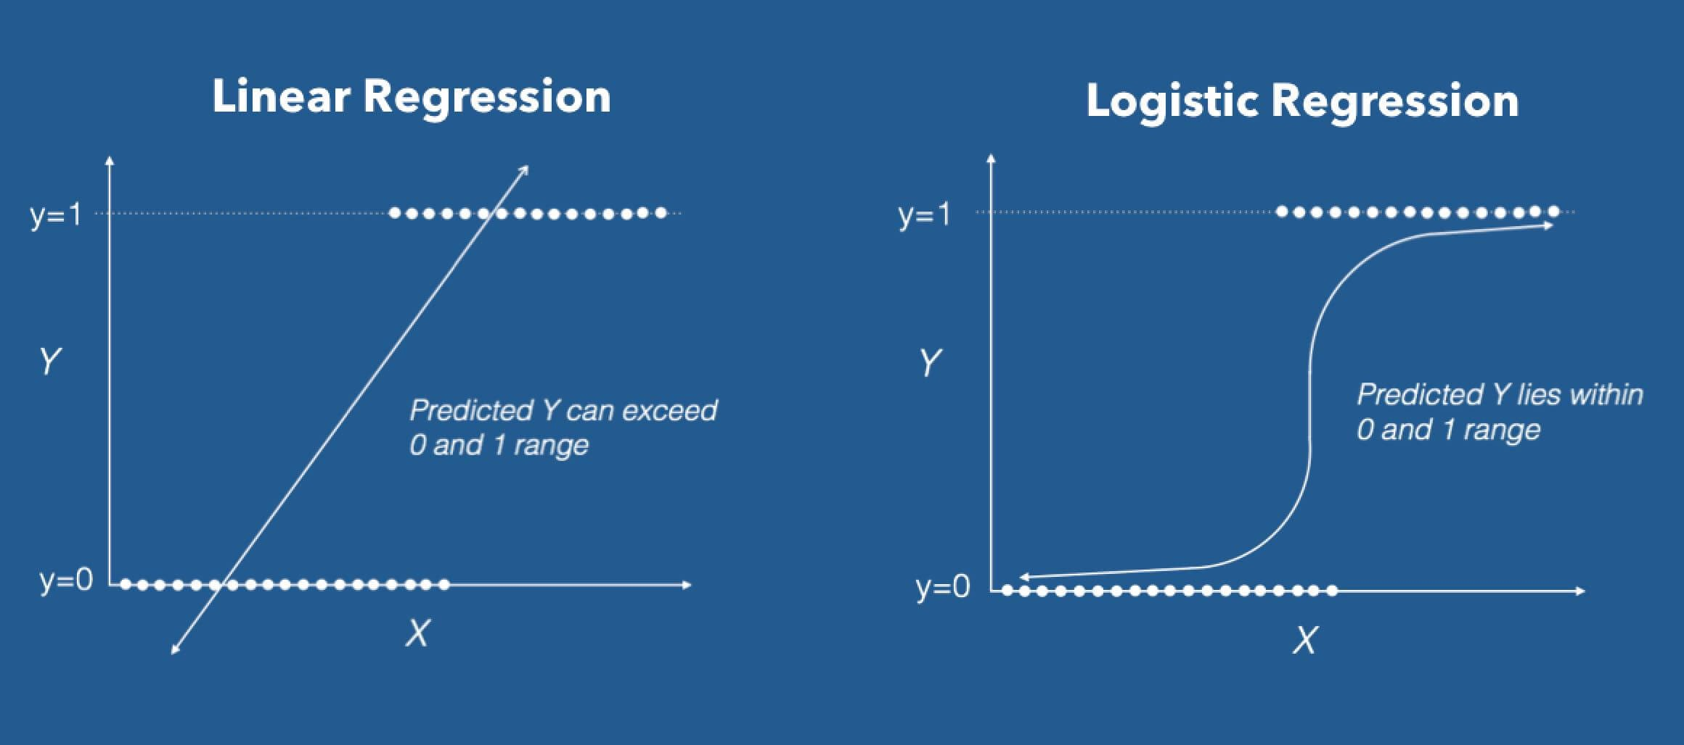
Logistic Regression
Sigmoid function

Slide 84
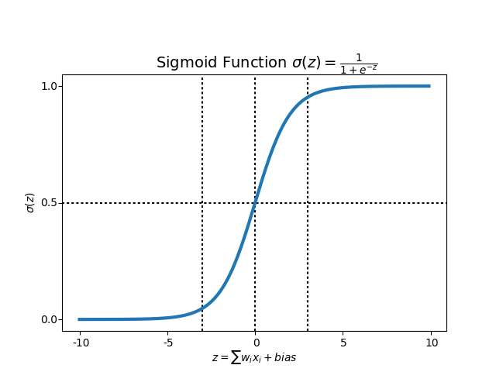
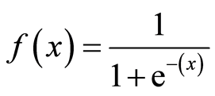
Logistic Regression
Sigmoid Function
Represents the odds that an attribute to be the class “A” or “not A”.
Represents the uncertainty.

Slide 85
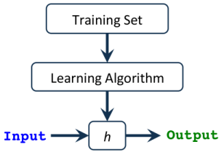
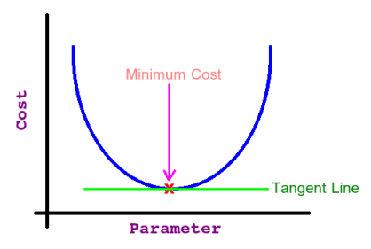
Logistic Regression
The task is to find the best Parameters (Weights) that give us the least error in predicting the output.
We call this error a Cost or Loss Function and apparently our goal is to minimize it in order to get the best predicted output!
The relation between the parameter value and its effect on the cost function (i.e., the error) looks like a bell curve (i.e., Quadratic) .

Slide 86
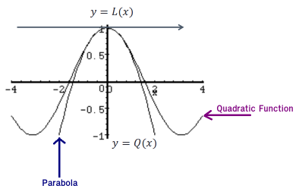
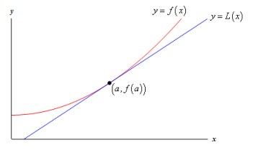
Select the technique: Logistic Regression
Linear Approximation:
Quadratic Approximation:
Fit better with the logistic function

Slide 87
Cost Function
Represents optimization objective i.e., we create a cost function and minimize it so that we can develop an accurate model with minimum error.
Gradient Descent (Solvers)
Now the question arises, how do we reduce the cost value?
The main goal of Gradient descent is to minimize the cost value. i.e., min J(θ).

Slide 88
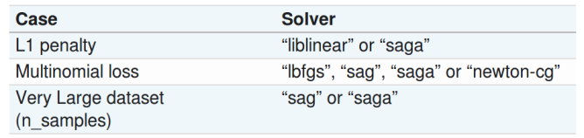
Solvers

Slide 89
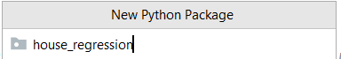
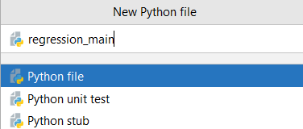
The code solution
Create a package to organize the project files.
(Right Click over projects): New -> Python Package ..
Create the main python file.
(Right Click over cyber_ml): New -> Python Package ..

Slide 90
The code solution
Create a resource folder, which is the place where all support files will be store (ex.: datasets, etc.)
(Right Click over resources): New -> Directory ...
Copy the data1.csv to local resource folder

Slide 91
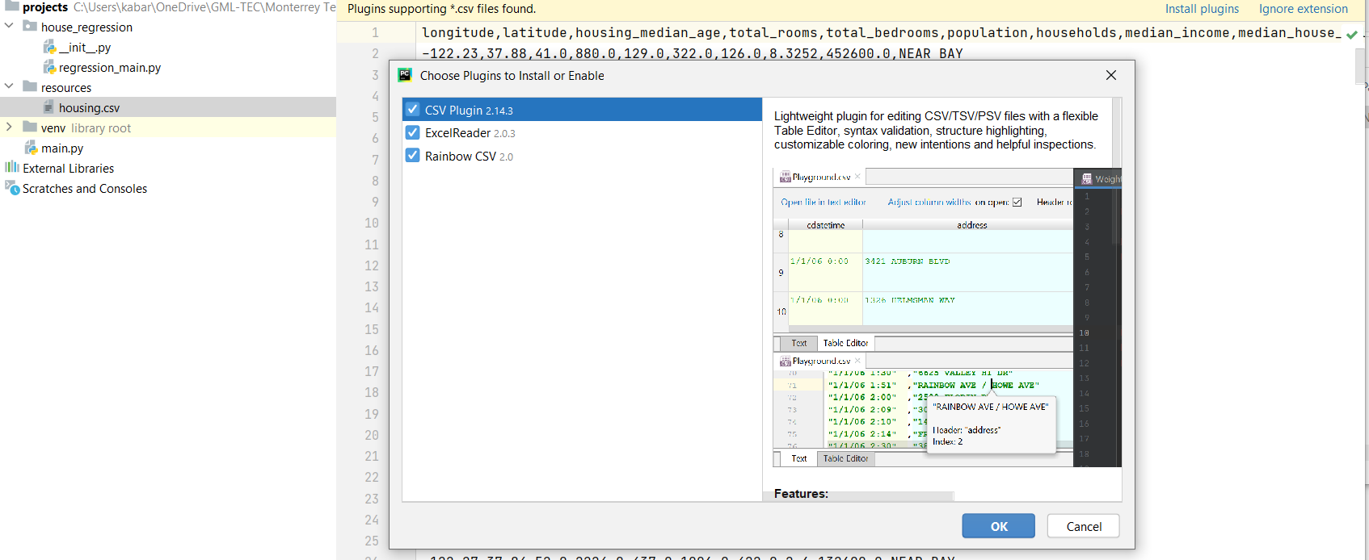
CSV Plugin Install

Slide 92
ML General Methods
[password, score]
Study the problem and domain
[0] for weak;
[1] for medium; and
[2] for strong.
Define the features and the algorithm
Import dataset
import pandas as pd data = pd.read_csv('resources/data1.csv', low_memory=False)

Slide 93
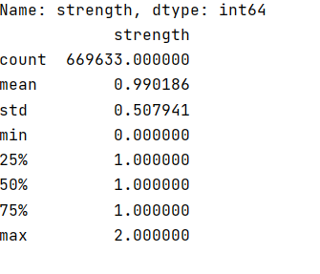
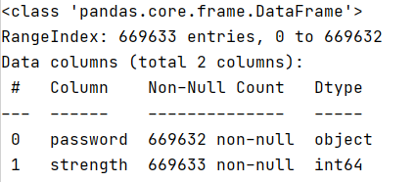
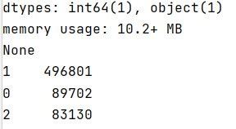
ML General Methods
Study the problem and domain
Define the features and the algorithm
print(data.info()) print(data["strength"].value_counts()) print(data.describe())
Import dataset
Analyze the dataset

Slide 94
ML General Methods
# For text feature extraction from sklearn.feature_extraction.text import TfidfVectorizer # For creating a pipeline from sklearn.pipeline import Pipeline # Classifier Model (Logistic Regression) from sklearn.linear_model import LogisticRegression # Sequentially apply a list of transforms and a final estimator classifier_model = Pipeline([ ('tfidf', TfidfVectorizer(analyzer='char')), ('logisticRegression',LogisticRegression(multi_class='multinomial', solver='sag')), ])
Study the problem and domain
Define the features and the algorithm
Import dataset
Analyze the dataset
Instantiate the ML model

Slide 95
ML General Methods
# For text feature extraction from sklearn.feature_extraction.text import TfidfVectorizer # For creating a pipeline from sklearn.pipeline import Pipeline # Classifier Model (Logistic Regression) from sklearn.linear_model import LogisticRegression # Sequentially apply a list of transforms and a final estimator classifier_model = Pipeline([ ('tfidf', TfidfVectorizer(analyzer='char')), ('logisticRegression',LogisticRegression(multi_class='multinomial', solver='sag')), ])
Study the problem and domain
The value tf – idf (short for English term frequency – inverse document frequency, which means frequency of the term – inverse frequency in documents), is a statistical measure intended to indicate the relative importance of a word in a document in relation to a collection of documents or in a linguistic corpus.
Define the features and the algorithm
Import dataset
Analyze the dataset
Instantiate the ML model

Slide 96
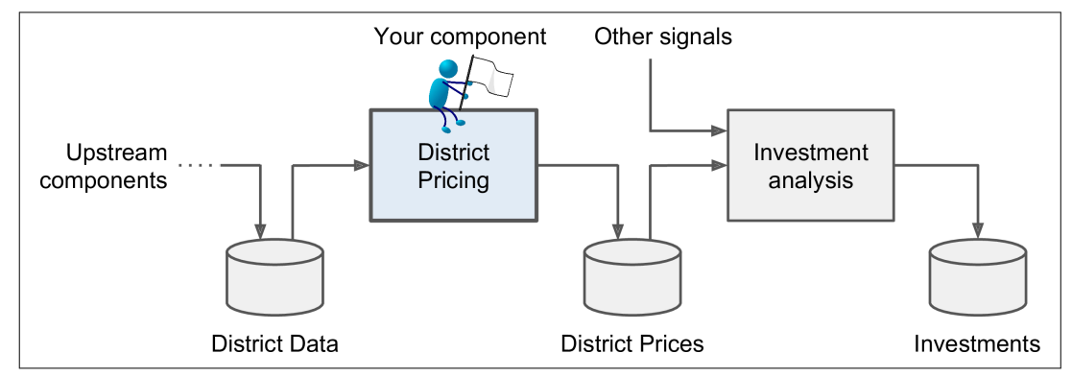
ML General Methods
# For text feature extraction from sklearn.feature_extraction.text import TfidfVectorizer # For creating a pipeline from sklearn.pipeline import Pipeline # Classifier Model (Logistic Regression) from sklearn.linear_model import LogisticRegression # Sequentially apply a list of transforms and a final estimator classifier_model = Pipeline([ ('tfidf', TfidfVectorizer(analyzer='char')), ('logisticRegression',LogisticRegression(multi_class='multinomial', solver='sag')), ])
Study the problem and domain
Define the features and the algorithm
Import dataset
Analyze the dataset
Instantiate the ML model
Notes:
Components typically run asynchronously. Each component pulls in a large amount of data, processes it, and spits out the result in another data store, and then some time later the next component in the pipeline pulls this data and spits out its own output.

Slide 97
ML General Methods
# For text feature extraction from sklearn.feature_extraction.text import TfidfVectorizer # For creating a pipeline from sklearn.pipeline import Pipeline # Classifier Model (Logistic Regression) from sklearn.linear_model import LogisticRegression # Sequentially apply a list of transforms and a final estimator classifier_model = Pipeline([ ('tfidf', TfidfVectorizer(analyzer='char')), ('logisticRegression',LogisticRegression(multi_class='multinomial', solver='sag')), ])
Study the problem and domain
Define the features and the algorithm
Import dataset
Analyze the dataset
Instantiate the ML model

Slide 98
ML General Methods
Study the problem and domain
Define the features and the algorithm
Split dataset into training and test set
Import dataset
Analyze the dataset
Instantiate the ML model

Slide 99
Training, validation, and test sets
A training dataset is a dataset of examples used during the learning process and is used to fit the parameters (e.g., weights) of, for example, a classifier.
A test dataset is a dataset that is independent of the training dataset, but that follows the same probability distribution as the training dataset. If a model fit to the training dataset also fits the test dataset well, minimal overfitting has taken place. A better fitting of the training dataset as opposed to the test dataset usually points to overfitting.
A validation dataset is a dataset of examples used to tune the hyperparameters (i.e., the architecture) of a classifier.

Slide 100
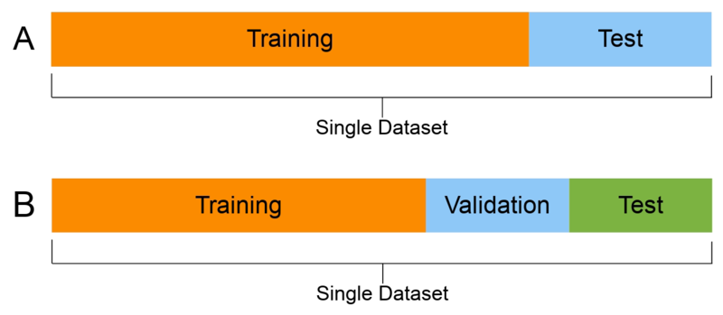
Training, validation, and test sets
Dataset A only uses a training set and a test set. The test set would be used to test the trained model.
For Dataset B, the validation set would be used to test the trained model, and the test set would evaluate the final model.

Slide 101
ML General Methods
from sklearn.model_selection import train_test_split train_set, test_set = train_test_split(data, test_size=0.2, random_state=42)
Controls the shuffling applied to the data before applying the split. Pass an int for reproducible output across multiple function calls.
Test set size = 20% of data
Study the problem and domain
Define the features and the algorithm
Split dataset into training and test set
Import dataset
Analyze the dataset
Instantiate the ML model

Slide 102


Install scikit-learn

Slide 103

ML General Methods
# Features which are passwords features_train = train_set.values[:, 1].astype('str') features_test = test_set.values[:, 1].astype('str') # Labels which are strength of password (target of classification) labels_train = train_set.values[:, -1].astype('int') labels_test = test_set.values[:, -1].astype('int')
Study the problem and domain
Separate labels and features into different sets
feature
label
Define the features and the algorithm
Split dataset into training and test set
Import dataset
Analyze the dataset
Instantiate the ML model

Slide 104
ML General Methods
Study the problem and domain
classifier_model.fit(features_train, labels_train)
Define the features and the algorithm
Training ML model
Split dataset into training and test set
Import dataset
Analyze the dataset
Instantiate the ML model

Slide 105
ML General Methods
Study the problem and domain
Evaluate the model
Define the features and the algorithm
Training ML model
Split dataset into training and test set
Import dataset
Analyze the dataset
Instantiate the ML model

Slide 106
Accuracy Score Metrics
Evaluating your machine learning algorithm is an essential part of any project.
Your model may give you satisfying results when evaluated using a metric say accuracy_score but may give poor results when evaluated against other metrics such as logarithmic_loss or any other such metric.
Most of the times we use classification accuracy to measure the performance of our model, however it is not enough to truly judge our model.

Slide 107
ML General Methods
Study the problem and domain
Test the model
Define the features and the algorithm
Training ML model
Split dataset into training and test set
#Test the model predictions = classifier_model.predict(features_test) from sklearn.metrics import accuracy_score score = accuracy_score(labels_test,predictions) #score = classifier_model.score(features_test, labels_test) print('Accuracy of logistic regression classifier on test set: {:.2f}'.format(score)) from sklearn.metrics import confusion_matrix confusion_matrix = confusion_matrix(labels_test, predictions) print(confusion_matrix)
Import dataset
Analyze the dataset
Instantiate the ML model

Slide 108
ML General Methods
Study the problem and domain
Test the model
Define the features and the algorithm
Training ML model
Split dataset into training and test set
#Test the model predictions = classifier_model.predict(features_test) from sklearn.metrics import accuracy_score score = accuracy_score(labels_test,predictions) #score = classifier_model.score(features_test, labels_test) print('Accuracy of logistic regression classifier on test set: {:.2f}'.format(score)) from sklearn.metrics import confusion_matrix confusion_matrix = confusion_matrix(labels_test, predictions) print(confusion_matrix)
Import dataset
Analyze the dataset
Instantiate the ML model

Slide 109


Confusion Matrix
There are 4 important terms :
True Positives: The cases in which we predicted YES and the actual output was also YES.
True Negatives: The cases in which we predicted NO and the actual output was NO.
False Positives: The cases in which we predicted YES and the actual output was NO.
False Negatives: The cases in which we predicted NO and the actual output was YES.

Slide 110

ML General Methods
Study the problem and domain
Test the model
Define the features and the algorithm
Training ML model
Split dataset into training and test set
#Test the model predictions = classifier_model.predict(features_test) from sklearn.metrics import accuracy_score score = accuracy_score(labels_test,predictions) #score = classifier_model.score(features_test, labels_test) print('Accuracy of logistic regression classifier on test set: {:.2f}'.format(score)) from sklearn.metrics import confusion_matrix confusion_matrix = confusion_matrix(labels_test, predictions) print(confusion_matrix)
Import dataset
Analyze the dataset
Instantiate the ML model

Slide 111


ML General Methods
[0] for weak;
[1] for medium; and
[2] for strong.
26% strong
26% weak
Study the problem and domain
Test the model
Run the model in production env
48% medium
Define the features and the algorithm
Training ML model
Split dataset into training and test set
input_data = ['faizanahmad','faizanahmad123','faizanahmad##','ajd1348#28t**','ffffffffff', 'kuiqwasdi','uiquiuiiuiuiuiuiuiuiuiuiui','mynameisfaizan','mynameis123faizan#', 'faizan','123456','abcdef'] res_predictions = classifier_model.predict_proba(input_data) print(res_predictions)
Import dataset
Analyze the dataset
Instantiate the ML model

Slide 112
Unit 1 – Introduction to Computational Learning
Outline
Cyber Security Foundations
What is Machine Learning?
Machine Learning and Cyber Security
Ethics Questions
Practical Example of Machine Learning

Slide 113
Computational Intelligence (TC3023)

